Slide 1
Avoiding Investment Fraud

Slide 2
The Oklahoma Department of Securities Invest Ed® program has provided this information as a service to investors. Invest Ed does not recommend any particular investment strategy or plan, any type of product, or any securities professional over another. No part of Invest Ed shall be taken as investment and/or legal advice.

Slide 3
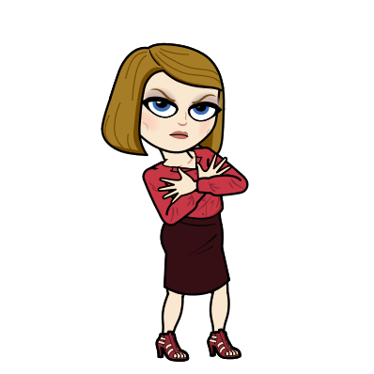
Investment fraud
Is a scheme where an individual or group of individuals offer or sell securities by deceiving investors and making false claims or half-truths about investment products.
Notes:
Investing requires careful research. You must protect your assets by avoiding investment frauds.
Investment fraud is a scheme where an individual or group of individuals offer or sell securities by deceiving investors and making false claims or half-truths about investment products.

Slide 4

Frauds
Involve deception
Disguising the truth
Misleading investors
And often outright theft of investor money
Notes:
Frauds involve deception, disguising the truth, misleading investors, and often outright theft of investor money.
There are an unlimited number of financial scams and frauds. While the list is too numerous to discuss in one presentation, we can highlight some popular frauds that seem to appear with regularity.

Slide 5
Ponzi Scheme
Usually offers a promise of high returns with little or no risk.
When new investors deposit money, the Ponzi manager does not actually invest in what he advertises; he spends the money for personal benefit and gives some to original investors who expect a return on their investment.
Is an investment fraud where the manager has made no real investments, and pays previous investors with new investor money.
Notes:
Ponzi schemes
A Ponzi scheme is an investment fraud where the manager has no real investments, or has lost most or all of the original investors’ money. This type of fraud pays existing investors with funds collected from new investors.
Usually offers a promise of high returns with little or no risk.
When new investors deposit money, the Ponzi manager does not actually invest in what he advertises; he sends the money to existing investors who expect a return on their original investment.

Slide 6
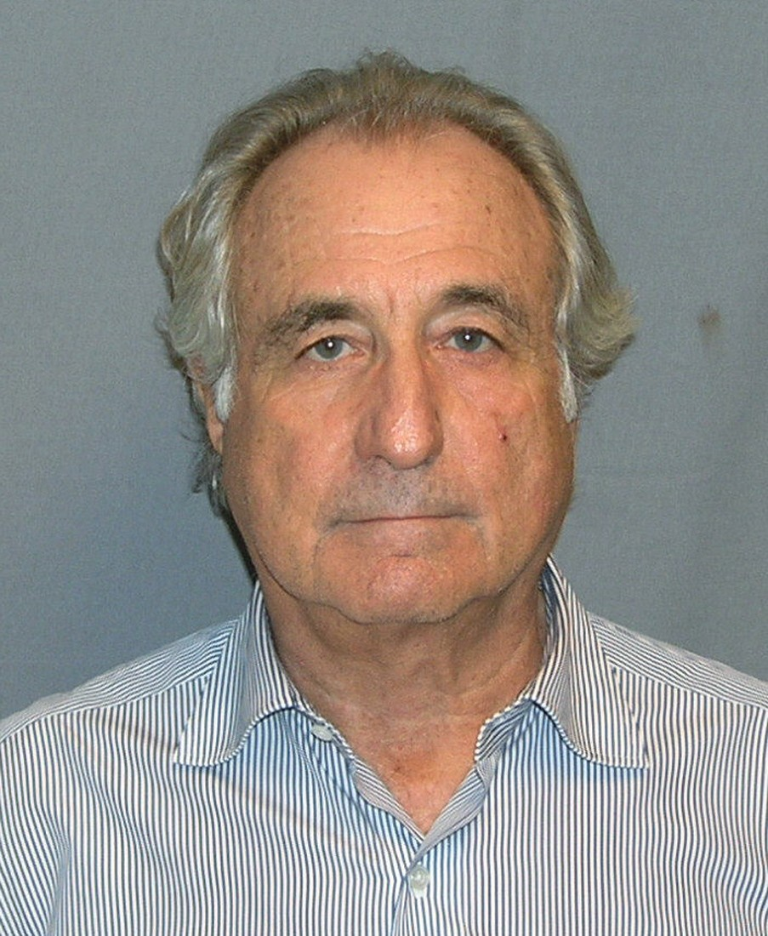
Ponzi Scheme
Bernard (Bernie)
Madoff
Can only continue as long as it can attract new assets.
Madoff ran the largest ponzi in the history of finance from 1990 to 2008.
Notes:
A Ponzi scheme can only continue as long as it can attract new assets.
These frauds usually collapse during difficult financial times when investors feel more risk averse and avoid new investments.
Bernard Madoff ran the largest Ponzi scheme in the history of finance. He began the scheme in the early 1990’s and finally confessed to his fraud in late 2008. At one point Madoff, who claimed to be running a hedge fund, “managed” $18 billion of investor money. His company perpetrated a classic example of affinity fraud-- his social group consisted of wealthy families and charities. The Madoff fund appeared to be an exclusive club that investors were practically begging to join. Madoff will spend the rest of his life in prison. Investors will recover approximately 75% of the money invested, which is rare for a Ponzi scheme.
In Shawnee, Oklahoma, Bill Hickman stole $12 million of investor money in a Ponzi scheme that was uncovered in 2004. Hickman sold unregistered securities that promised high returns with little risk. An Invest Ed documentary of Hickman’s crimes is available on the investedok.org website. The investors in Hickman’s scheme received no return on their original investment.
https://commons.wikimedia.org/wiki/File:BernardMadoff.jpg

Slide 7
Affinity Fraud
A financial scheme marketed to members of a specific group, such as a church congregation, ethnic group, senior citizen group, or social club.
Fraudsters integrate themselves with the leaders of group and blend in with others
Fraudsters exploit a sense of belonging and trust that exists in group
A con artist looks like a professional and blends into the group of potential victims
Notes:
Affinity fraud
Financial schemes marketed to members of a specific group, such as a church congregation, ethnic group, senior citizen group, or social club. The perpetrators ingratiate themselves with the leaders of the group and blend in with the other group members. Inside a social group there exists a sense of belonging and trust that fraudsters exploit. A con artist attempts to blend into the group of potential victims.

Slide 8
Pump & Dump Stock Scheme
A stock promoter will buy a large block of a penny stock, usually $1 or less per share, talk the stock up to other investors, then dump (sell) the shares at a large profit before the stock falls.
Notes:
“Pump and dump” stock schemes:
Penny stocks are low priced stocks, usually less than $1 per share. A stock promoter will purchase a large block of shares of these dubious companies, tell his customers to buy shares of the stock, while he sells his shares, makes a profit. Meanwhile the customers now hold a questionable company at inflated prices.

Slide 9
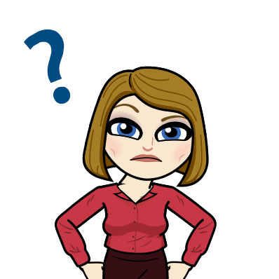
Questions??
Contact the Oklahoma Department of Securities
securities.ok.gov
There is a link to ask questions
To investigate a securities professional
A phone number to call
About an investment offer
About an individual
Notes:
If you have any questions about an investment offer, or any questions about an individual, contact your state securities regulator. In Oklahoma, contact the Oklahoma Department of Securities at securities.ok.gov.
There is a link to ask questions and investigate your securities professional, and a phone number to call.
A list of recent enforcement actions taken by the Oklahoma Department of Securities are available on the securities.ok.gov website. You can search enforcement actions as well.

Slide 10
To avoid investment fraud:
Only use registered securities professionals
Always ask for written information about an investment, like a prospectus
Do not take what you hear or read at face value; be skeptical of any claims
Notes:
Suggestions on how to avoid investment fraud:
Only deal with registered Investment Advisers, Investment Adviser Representatives, Broker-Dealers, and Broker-Dealer Agents. You can check if an investment professional is registered in Oklahoma by visiting securities.ok.gov and clicking on “Is your securities professional registered?” or on BrokerCheck.finra.org.
Always ask for written information about an investment, like a prospectus. A prospectus is a document that contains a description of the investment, the manager’s strategy, the risks, and any relevant financial information. Review the prospectus and check to see if the financial information has been audited and submitted to regulators.
Do not take what you hear or read at face value; be skeptical of any claims.

Slide 11
To avoid investment fraud:
Ignore claims that an investment has no downside risk. No investment is risk-free, and the potential of loss should always be considered.
If it sounds to good to be true, it probably is.
Notes:
Avoid investing with people who claim that an investment has no downside risk. No investment is risk-free, and the potential of loss should always be considered.
Let common sense prevail. If it sounds too good to be true, it probably is. Be skeptical of any unrealistic claims.

Slide 12
To avoid investment fraud:
Do not pay advance fees or money upfront.
Understand any financial figures and presentations. Take your time. Never feel rushed.
Never make emotional decisions; it is perfectly fine to “sleep on it”.
Never be embarrassed to report fraud, or warn others.
Get periodic statements or reports and keep up with your investments.
Contact the Oklahoma Department of Securities if you suspect something.
Notes:
Avoid paying advance fees or money upfront.
Understand any financial figures and presentations .Take your time. Never feel rushed.
Never make emotional decisions; it is perfectly fine to “sleep on it”.
Never be embarrassed to report fraud, or warn others. Contact the Oklahoma Department of Securities if you suspect something.
Get statements or reports and keep up with your investments.

Slide 13

Questions for your securities professional:
Are you registered to sell investments in this state?
Notes:
Are you a registered to sell investments in this state?
Do you have any enforcement actions against you?
Have you ever been sued by a client or professional colleague?

Slide 14
Questions for your securities professional:
What are the fees and commissions?
Notes:
Questions for your investment professional:
Never be afraid to ask tough questions. It’s your money, after all. If a financial salesperson is offering you an investment opportunity, you should ask them:
What are the fees and commissions?

Slide 15
Questions for your securities professional:
How often will I receive statements?
Notes:
How often will I receive statements? Anything less than quarterly is unacceptable.

Slide 16
Questions for your securities professional:
Do you have any references?
Notes:
Do you have any references?

Slide 17
Questions for your securities professional:
Have any enforcement actions been taken against you?
Notes:
Have any enforcement actions been taken against you?

Slide 18
Questions for your securities professional:
Have you ever been sued by a client or professional colleague?
Notes:
Have you ever been sued by a client or professional colleague?

Slide 19
A promise of high return with low risk
Unregistered investments
Complex and obscure investments
Phrases like “getting in on the ground floor” & “guaranteed” or unrealistic claims about performance
RED Flag warnings:
Notes:
Red flags (warnings) that you may be dealing with a fraud:
A promise of high return with low risk.
Unregistered investments. All securities sold in your state must be registered or exempt from registration with the state securities department.
Unregistered investment professionals. Always ask if your investment professional is registered to transact business in your state.
Complex and obscure investments. Ask yourself, do you understand how this business makes money?
The salesperson mentions “getting in on the ground floor”, “guaranteed”, unrealistic claims about performance.
Paperwork issues and lack of documentation.
Difficulty receiving payments, or promised payments do not arrive on time.
Stalling tactics when you want something you have been promised, like interest or principal payments.

Slide 20
Paperwork issues and lack of documentation
Difficulty receiving payments
Stalling tactics when you want something you have been promised, like interest or principal payments.
RED Flag warnings:
Notes:
Paperwork issues and lack of documentation.
Difficulty receiving payments, or promised payments do not arrive on time.
Stalling tactics when you want something you have been promised, like interest or principal payments.

Slide 21

Tips to avoid online financial scams
Never wire or send money electronically to a stranger
Do not give out financial information online to strangers, especially in emails
Never make checks payable to an individual
Notes:
Tips to avoid online financial scams
In today’s world, many of our financial transactions take place from our home on our computers or on our mobile devices. Here is some advice when to avoid online investment fraud:
Never wire or send money electronically to a stranger
Do not give out financial information online to strangers, especially in emails
Never make checks payable to an individual

Slide 22

Resources
Securities.ok.gov
Investedok.org
Investor.gov
SEC.gov
Saveandinvest.org
FINRA.org
Notes:
Resources:
Here are some excellent resources to further investigate financial fraud:
(Show these websites and links)
Securities.ok.gov, contact us with this link
Investedok.org
Investor.gov
SEC.gov
Saveandinvest.org
Finra.gov

Slide 23
Terms
risk
Ponzi scheme
investment fraud
affinity fraud
pump & dump scheme
penny stock

